Slide 1
CS 1678: Intro to Deep Learning Transformers
Prof. Adriana Kovashka University of Pittsburgh
March 18, 2024

Slide 2
Plan for this lecture
Background
Context prediction, unsupervised learning
Transformer models
Self-attention
Adapting self-attention for sequential data
The transformer architecture, encoder/decoder
Pre-training, BERT, GPT
Transformers beyond language

Slide 3
Additional resources
Learning about transformers on your own?
Key recommended resource:
http://nlp.seas.harvard.edu/2018/04/03/attention.html
The Annotated Transformer by Sasha Rush
Jupyter Notebook using PyTorch that explains everything!
The Illustrated Transformer
http://jalammar.github.io/illustrated-transformer/
Attention visualizer
https://github.com/jessevig/bertviz
Adapted from Christopher Manning

Slide 4
How do we represent the meaning of a word?
Definition: meaning (Webster dictionary)
the idea that is represented by a word, phrase, etc.
the idea that a person wants to express by using words, signs, etc.
the idea that is expressed in a work of writing, art, etc. Commonest linguistic way of thinking of meaning:
signifier (symbol) ⟺ signified (idea or thing)
= denotational semantics
Christopher Manning

Slide 5

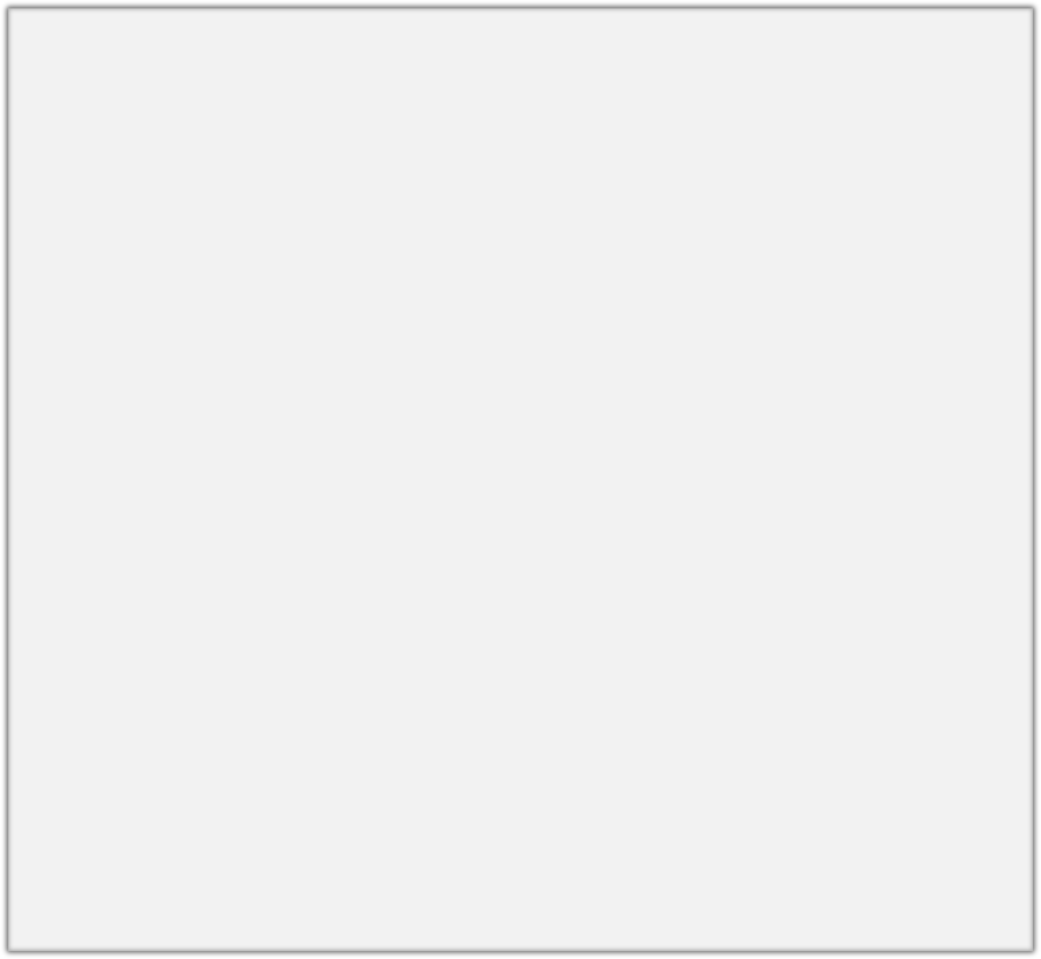
How do we have usable meaning in a computer?
Common solution: Use e.g. WordNet, a thesaurus containing lists of synonym sets and hypernyms (“is a” relationships).
e.g. synonym sets containing “good”: e.g. hypernyms of “panda”:
from nltk.corpus import wordnet as wn
poses = { 'n':'noun', 'v':'verb', 's':'adj (s)', 'a':'adj', 'r':'adv'}
for synset in wn.synsets("good"):
print("{}: {}".format(poses[synset.pos()],
", ".join([l.name() for l in synset.lemmas()])))
from nltk.corpus import wordnet as wn panda = wn.synset("panda.n.01") hyper = lambda s: s.hypernyms() list(panda.closure(hyper))
noun: good
noun: good, goodness noun: good, goodness
noun: commodity, trade_good, good adj: good
adj (sat): full, good adj: good
adj (sat): estimable, good, honorable, respectable adj (sat): beneficial, good
adj (sat): good
adj (sat): good, just, upright
…
adverb: well, good
adverb: thoroughly, soundly, good
[Synset('procyonid.n.01'), Synset('carnivore.n.01'), Synset('placental.n.01'), Synset('mammal.n.01'), Synset('vertebrate.n.01'), Synset('chordate.n.01'), Synset('animal.n.01'), Synset('organism.n.01'), Synset('living_thing.n.01'), Synset('whole.n.02'),
Synset('object.n.01'), Synset('physical_entity.n.01'), Synset('entity.n.01')]
Christopher Manning

Slide 6
Problems with resources like WordNet
Great as a resource but missing nuance
e.g. “proficient” is listed as a synonym for “good”. This is only correct in some contexts.
Missing new meanings of words
e.g., wicked, badass, nifty, wizard, genius, ninja, bombest
Impossible to keep up-to-date!
Subjective
Requires human labor to create and adapt
Can’t compute accurate word similarity
Christopher Manning

Slide 7
Representing words as discrete symbols
In traditional NLP, we regard words as discrete symbols: hotel, conference, motel – a localist representation
Means one 1, the rest 0s
Words can be represented by one-hot vectors:
motel = [0 0 0 0 0 0 0 0 0 0 1 0 0 0 0]
hotel = [0 0 0 0 0 0 0 1 0 0 0 0 0 0 0]
Vector dimension = number of words in vocab (e.g. 500,000)
Christopher Manning

Slide 8
Problem with words as discrete symbols
Sec. 9.2.2
Example: in web search, if user searches for “Seattle motel”, we would like to match documents containing “Seattle hotel”.
But:
motel = [0 0 0 0 0 0 0 0 0 0 1 0 0 0 0]
hotel = [0 0 0 0 0 0 0 1 0 0 0 0 0 0 0]
These two vectors are orthogonal.
There is no natural notion of similarity for one-hot vectors!
Solution:
Could try to rely on WordNet’s list of synonyms to get similarity?
But it is well-known to fail badly: incompleteness, etc.
Instead: learn to encode similarity in the vectors themselves
Christopher Manning

Slide 9
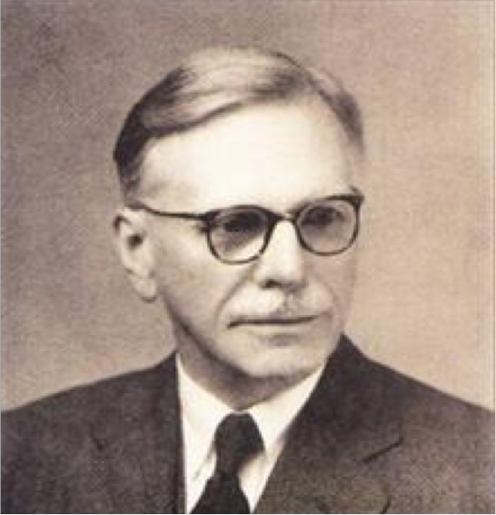
Representing words by their context
Distributional semantics: A word’s meaning is given by the words that frequently appear close-by
“You shall know a word by the company it keeps” (J. R. Firth 1957)
One of the most successful ideas of modern statistical NLP!
When a word w appears in a text, its context is the set of words that appear nearby (within a fixed-size window).
Use the many contexts of w to build up a representation of w
…government debt problems turning into
…saying that Europe needs unified
…India has just given its
banking
banking banking
crises as happened in 2009…
regulation to replace the hodgepodge… system a shot in the arm…
These context words will represent banking
Christopher Manning

Slide 10
What can we learn from reconstructing the input?
Stanford University is located in , California.
John Hewitt

Slide 11
What can we learn from reconstructing the input?
I put fork down on the table.
John Hewitt

Slide 12
What can we learn from reconstructing the input?
The woman walked across the street, checking for traffic over shoulder.
John Hewitt

Slide 13
What can we learn from reconstructing the input?
I went to the ocean to see the fish, turtles, seals, and .
John Hewitt

Slide 14
What can we learn from reconstructing the input?
Overall, the value I got from the two hours watching it was the sum total of the popcorn and the drink.
The movie was .
John Hewitt

Slide 15
What can we learn from reconstructing the input?
Iroh went into the kitchen to make some tea.
Standing next to Iroh, Zuko pondered his destiny.
Zuko left the .
John Hewitt

Slide 16
What can we learn from reconstructing the input?
I was thinking about the sequence that goes 1, 1, 2, 3, 5, 8, 13, 21,
John Hewitt

Slide 17
Word vectors
We will build a dense vector for each word, chosen so that it is similar to vectors of words that appear in similar contexts
0.286
0.792
−0.177
−0.107
0.109
−0.542
0.349
0.271
banking =
Note: word vectors are sometimes called word embeddings or word representations. They are a distributed representation.
Christopher Manning

Slide 18
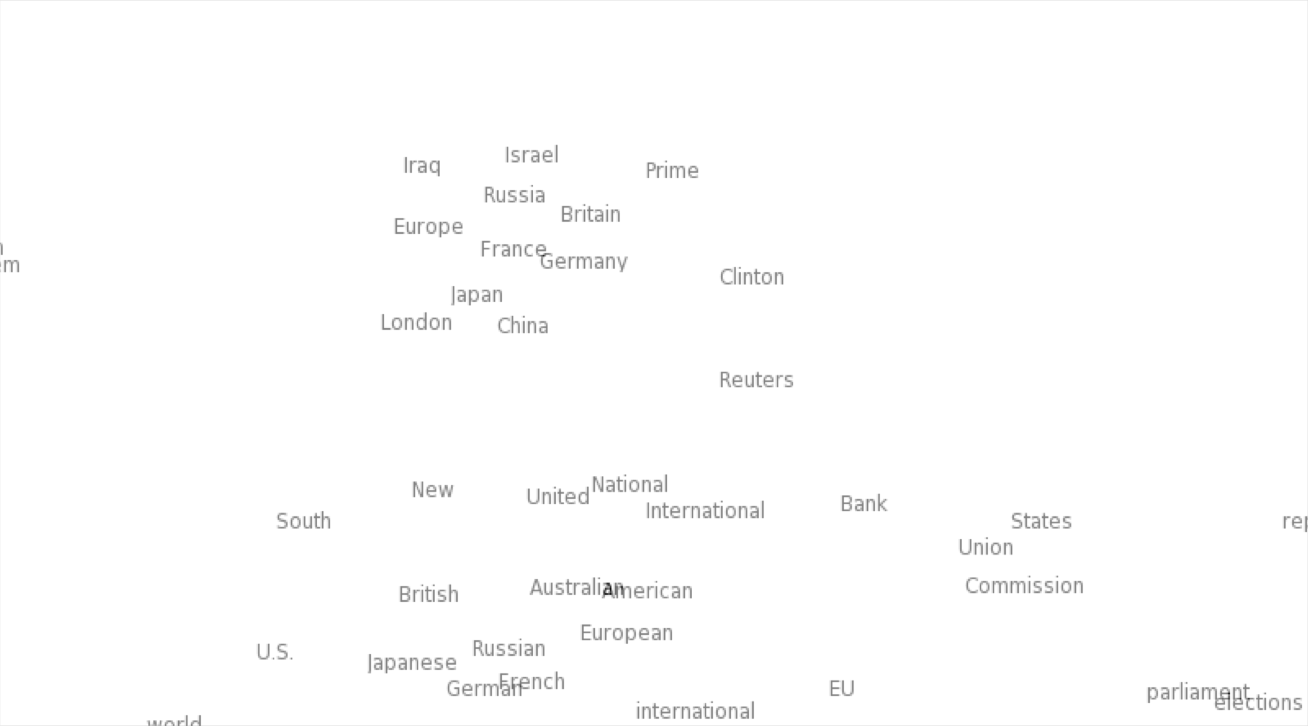

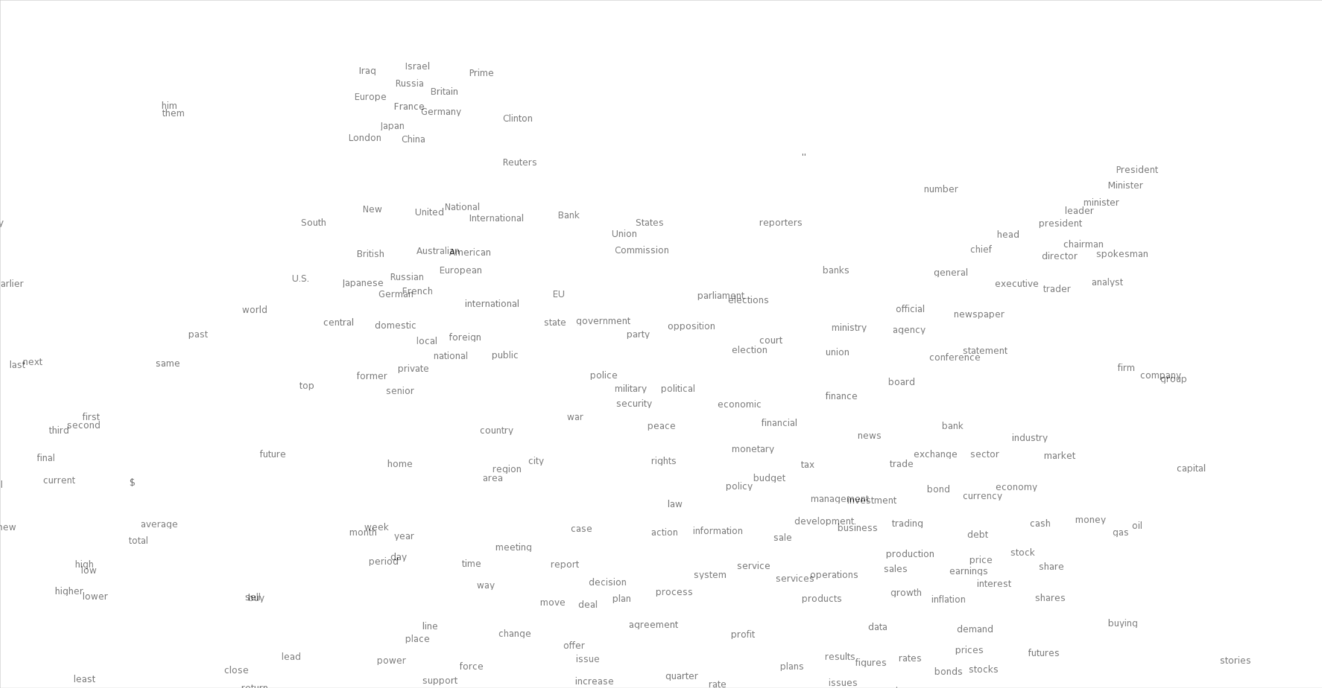
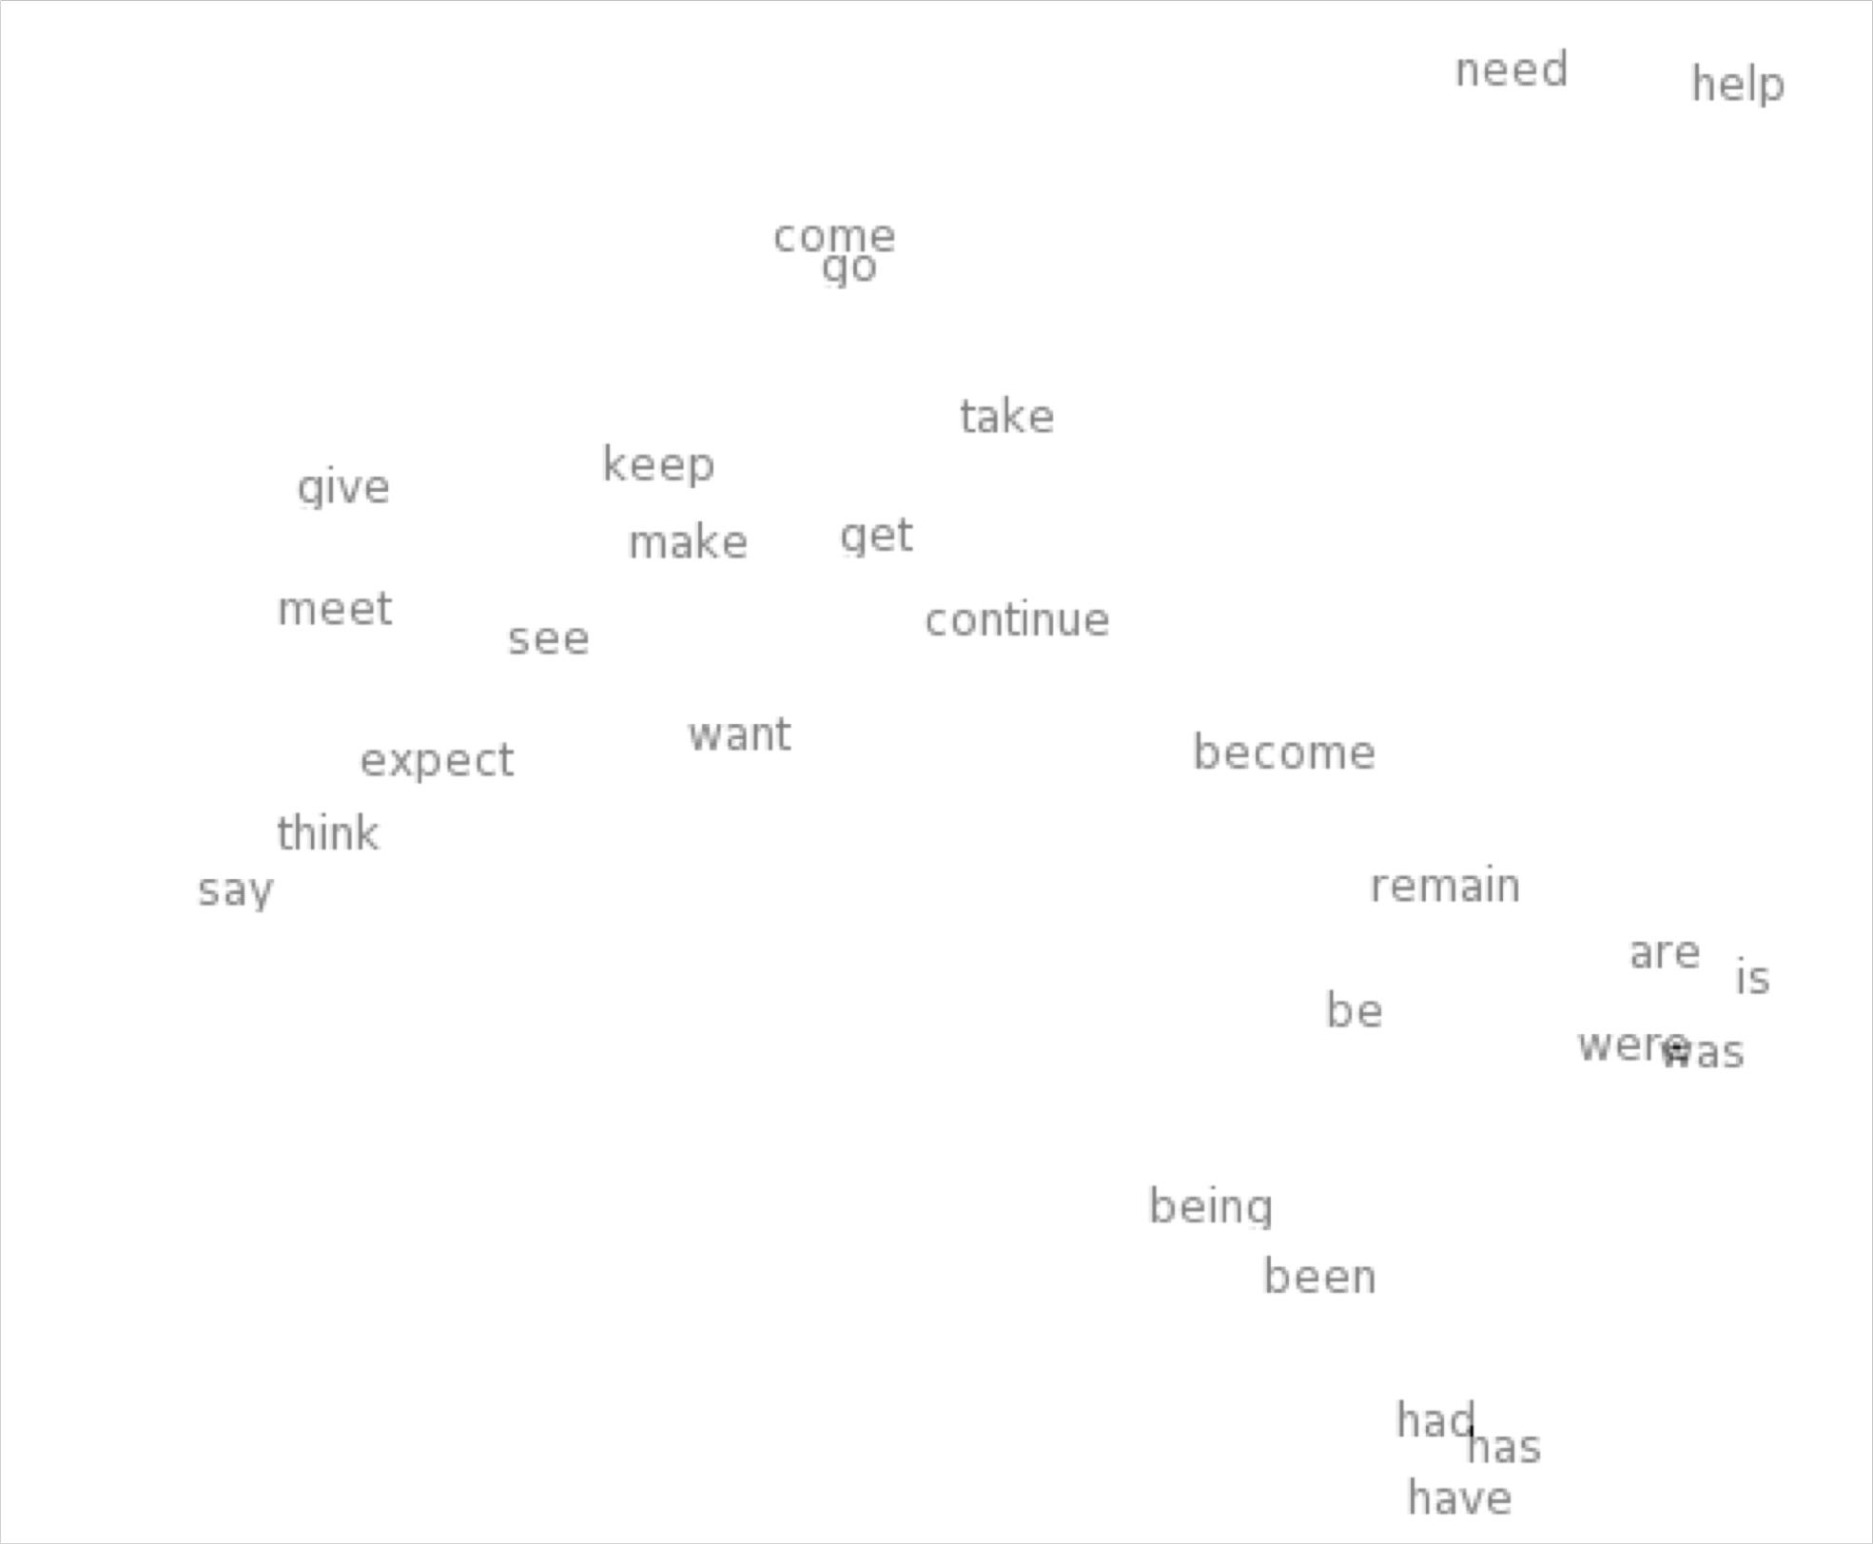
Word meaning as a neural word vector – visualization
0.286
0.792
−0.177
−0.107
0.109
−0.542
0.349
0.271
0.487
expect =
Christopher Manning

Slide 19
Word2Vec Overview
Word2vec (Mikolov et al. 2013) is a framework for learning word vectors
Idea:
We have a large corpus of text
Every word in a fixed vocabulary is represented by a vector
Go through each position t in the text, which has a center word
c and context (“outside”) words o
Use the similarity of the word vectors for c and o to calculate the probability of o given c (or vice versa)
Keep adjusting the word vectors to maximize this probability
Christopher Manning

Slide 20
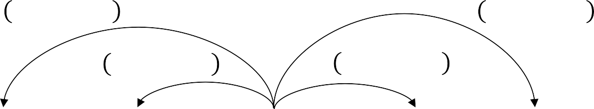
Word2Vec Overview
Example windows and process for computing P(w_{t+j}|w_{t})
P w_{t-2}|w_{t}
P w_{t+2}|w_{t}
P w_{t-1}|w_{t}
P w_{t+1}|w_{t}
…
problems
turning
into
banking
crises
as
…
outside context words in window of size 2
center word at position t
outside context words in window of size 2
Christopher Manning

Slide 21
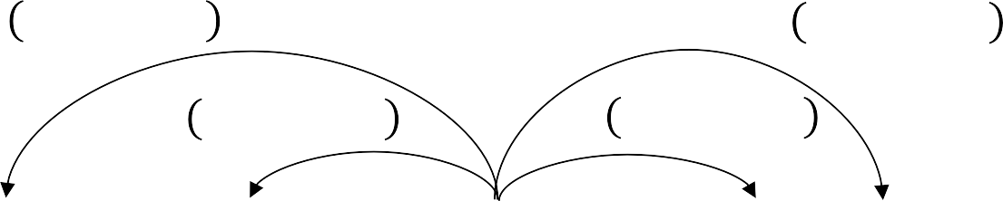
Word2Vec Overview
Example windows and process for computing P(w_{t+j}|w_{t})
P w_{t-2}|w_{t}
P w_{t+2}|w_{t}
P w_{t-1}|w_{t}
P w_{t+1}|w_{t}
…
problems
turning
into
banking
crises
as
…
outside context words in window of size 2
center word at position t
outside context words in window of size 2
Christopher Manning

Slide 22
Word2Vec: objective function
For each position t = 1, … , T, predict context words within a window of fixed size m, given center word w_{j}.
The objective function is the (average) negative log likelihood:
Minimizing objective function ⟺ Maximizing predictive accuracy
Christopher Manning

Slide 23
Word2Vec: objective function
We want to minimize the objective function:
Question: How to calculate P(w_{t+j}|w_{t} ; θ)?
Answer: We will use two vectors per word w:
v_{w} when w is a center word
u_{w} when w is a context word
Then for a center word c and a context word o:
Christopher Manning

Slide 24
Word2Vec: prediction function
This is an example of the softmax function ℝ^{n} → ℝ^{n}
Christopher Manning

Slide 25
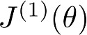
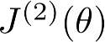
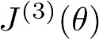
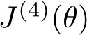
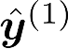
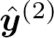
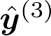
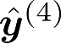

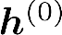
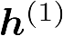
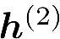
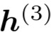
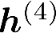



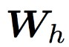




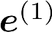
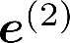
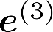
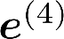
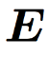
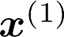
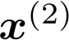
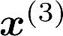
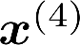
Recall: Recurrent Neural Networks (RNNs)
= negative log prob
of “students”
Loss
Predicted prob dists
…
Corpus
the
students
opened
their
exams
…
Abigail See

Slide 26
Issues with recurrent models: Linear interaction distance
O(sequence length) steps for distant word pairs to interact means:
Hard to learn long-distance dependencies (because gradient problems!)
Linear order of words is “baked in”; not necessarily the right way to think about sentences…
The chef who …
was
Info of chef has gone through O(sequence length) many layers!
Adapted from John Hewitt

Slide 27
Issues with recurrent models: Lack of parallelizability
Forward and backward passes have O(sequence length) unparallelizable operations
GPUs can perform a bunch of independent computations at once!
But future RNN hidden states can’t be computed in full before past RNN
hidden states have been computed
Inhibits training on very large datasets!
1
2
3
T
0
1
2
T-1
h₁ h₂
h_{T}
Numbers indicate min # of steps before a state can be computed
John Hewitt

Slide 28
If not recurrence, then what? How about word windows?
Word window models aggregate local contexts
Also known as 1D convolution
Number of unparallelizable operations not tied to sequence length!
window window embedding
2 |  | 2 |  | 2 |  | 2 |  | 2 |  | 2 |  | 2 |  | 2
1 |  | 1 |  | 1 |  | 1 |  | 1 |  | 1 |  | 1 |  | 1
0 |  | 0 |  | 0 |  | 0 |  | 0 |  | 0 |  | 0 |  | 0
h₁
h₂
h_{T}
Numbers indicate min # of steps before a state can be computed
Adapted from John Hewitt

Slide 29
If not recurrence, then what? How about word windows?
Word window models aggregate local contexts
What about long-distance dependencies?
Stacking word window layers allows interaction between farther words
But if your sequences are too long, you’ll just ignore long-distance context
window (size=5)
Red states
indicate those
“visible” to h_{k}
window (size=5) embedding
h₁
h_{k}
h_{T}
Too far from h_{k} to be considered
Adapted from John Hewitt

Slide 30
If not recurrence, then what? How about attention?
Attention treats each word’s representation as a query to access and incorporate information from a set of values.
We saw attention from the decoder to the encoder; today we’ll also think about attention within a single sentence.
If attention gives us access to any state… maybe we can just use attention and don’t need the RNN?
Number of unparallelizable operations not tied to sequence length.
All words interact at every layer!
2 |  | 2 |  | 2 |  | 2 |  | 2 |  | 2 |  | 2 |  | 2
1 |  | 1 |  | 1 |  | 1 |  | 1 |  | 1 |  | 1 |  | 1
0 |  | 0 |  | 0 |  | 0 |  | 0 |  | 0 |  | 0 |  | 0
All words attend
to all words in previous layer; most arrows here are omitted
attention
attention embedding
h₁
h₂
h_{T}
Adapted from John Hewitt

Slide 31
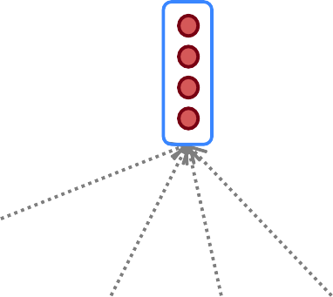
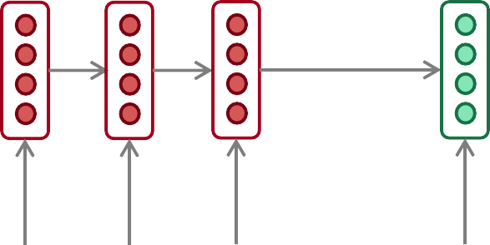
Recall: Sequence-to-sequence with attention
Attention output
Use the attention distribution to take a weighted sum of the encoder hidden states.
The attention output mostly contains information from the hidden states that received high attention.
Attention
distribution
Attention
scores
Decoder RNN
Encoder
RNN
il
a
m’ entarté
<START>
Source sentence (input)
Abigail See

Slide 32
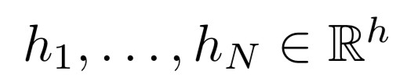
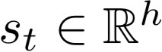
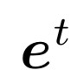
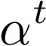
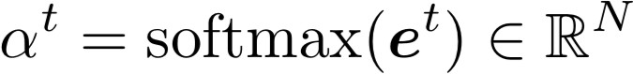
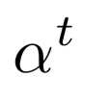
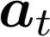
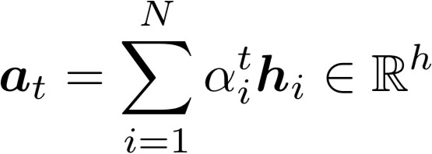
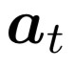
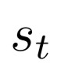
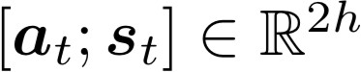
Recall: Attention in equations
We have encoder hidden states
On timestep t, we have decoder hidden state
We get the attention scores for this step:
We take softmax to get the attention distribution
a probability distribution and sums to 1)
for this step (this is
We use to take a weighted sum of the encoder hidden states to get the attention output
Finally we concatenate the attention output with the decoder hidden state and proceed as in the non-attention seq2seq model
Abigail See

Slide 33
Attention Notation: Queries, Keys, Values
Attention operates on queries, keys, and values.
We have some queries 𝑞 , 𝑞 , … , 𝑞 . Each query is 𝑞_{i} ∈ ℝ^{𝑑}
The number of queries can differ from the number of keys and
values in practice.
1 2 𝑇
We have some keys 𝑘₁, 𝑘₂, … , 𝑘_{𝑇}. Each key is 𝑘_{𝑖} ∈ ℝ^{𝑑}
We have some values 𝑣₁, 𝑣₂, … , 𝑣_{𝑇}. Each value is 𝑣_{𝑖} ∈ ℝ^{𝑑}
In self-attention, the queries, keys, and values are drawn from the same source.
For example, if the output of the previous layer is 𝑥₁, … , 𝑥_{𝑇}, (one vec per word) we could let 𝑣_{𝑖} = 𝑘_{𝑖} = 𝑞_{𝑖} = 𝑥_{𝑖} (that is, use the same vectors for all of them!)
The (dot product) self-attention operation is as follows:
exp(𝑒_{𝑖𝑗})
𝑒 = 𝑞_{i}^{𝖳}𝑘 𝛼 =
output = Σ _{𝑗} 𝛼 𝑣
𝑖𝑗 𝑗
𝑖j𝑗
𝑖 𝑖𝑗 𝑗
𝑖
Σ
_{𝑗'}
exp(𝑒_{𝑖𝑗’} )
Compute outputs as weighted sum of values
Compute key- query affinities
Compute attention weights from affinities
(softmax)
Adapted from John Hewitt

Slide 34
Key-Query-Value Attention
We saw that self-attention is when keys, queries, and values come from the same
source. The Transformer does this in a particular way:
Let 𝑥₁, … , 𝑥_{𝑇} be input vectors to the Transformer encoder; 𝑥_{𝑖} ∈ ℝ^{𝑑}
Then keys, queries, values are:
𝑘_{𝑖} = 𝐾𝑥_{𝑖}, where 𝐾 ∈ ℝ^{𝑑×𝑑} is the key matrix.
𝑞_{𝑖} = 𝑄𝑥_{𝑖}, where Q ∈ ℝ^{𝑑×𝑑} is the query matrix.
𝑣_{𝑖} = 𝑉𝑥_{𝑖}, where V ∈ ℝ^{𝑑×𝑑} is the value matrix.
These matrices allow different aspects of the 𝑥 vectors to be used/emphasized in each of the three roles.
John Hewitt

Slide 35
Key-Query-Value Attention
Let’s look at how key-query-value attention is computed, in matrices.
Let 𝑋 = 𝑥₁; … ; 𝑥_{𝑇} ∈ ℝ^{𝑇×𝑑} be the concatenation of input vectors.
First, note that 𝑋𝐾 ∈ ℝ^{𝑇×𝑑}, 𝑋𝑄 ∈ ℝ^{𝑇×𝑑}, 𝑋𝑉 ∈ ℝ^{𝑇×𝑑}.
𝖳
The output is defined as output = softmax 𝑋𝑄 𝑋𝐾 ^{T} × 𝑋𝑉.
First, take the query-key dot products in one matrix
All pairs of attention scores!
= 𝑋𝑄𝐾^{𝖳} 𝑋^{𝖳}
𝑋𝑄
multiplication: 𝑋𝑄 𝑋𝐾
𝖳
_{𝐾}𝖳 _{𝑋}𝖳
∈ ℝ
𝑇×𝑇
Next, softmax, and compute the weighted average with another matrix multiplication.
softmax
𝑋𝑄𝐾^{𝖳} 𝑋^{𝖳}
𝑋𝑉
=
output ∈ ℝ^{𝑇×𝑑}
John Hewitt

Slide 36
Multi-headed attention
What if we want to look in multiple places in the sentence at once?
For word 𝑖, self-attention “looks” where 𝑥^{𝖳}𝑄^{𝖳}𝐾𝑥_{𝑗} is high, but maybe we want
𝑖
to focus on different 𝑗 for different reasons?
We’ll define multiple attention “heads” through multiple Q,K,V matrices
𝑑
Let, 𝑄_{𝑃}, 𝐾_{𝑃}, 𝑉_{𝑃} ∈ ℝ ^{ℎ}, where ℎ is the number of attention heads, and 𝑃 ranges
from 1 to ℎ.
Each attention head performs attention independently:
𝑑×
output_{𝑃} = softmax 𝑋𝑄_{𝑃}𝐾^{𝖳}𝑋^{𝖳} ∗ 𝑋𝑉_{𝑃}, where output_{𝑃} ∈ ℝ^{𝑑/ℎ}
𝑃
Then the outputs of all the heads are combined!
output = 𝑌[output₁; … ; output_{ℎ}], where 𝑌 ∈ ℝ^{𝑑×𝑑}
Each head gets to “look” at different things, and construct value vectors
differently.
John Hewitt

Slide 37
Multi-headed attention
What if we want to look in multiple places in the sentence at once?
For word 𝑖, self-attention “looks” where 𝑥^{𝖳}𝑄^{𝖳}𝐾𝑥_{𝑗} is high, but maybe we want
𝑖
to focus on different 𝑗 for different reasons?
We’ll define multiple attention “heads” through multiple Q,K,V matrices
𝑑
Let, 𝑄_{𝑃}, 𝐾_{𝑃}, 𝑉_{𝑃} ∈ ℝ ^{ℎ}, where ℎ is the number of attention heads, and 𝑃 ranges
from 1 to ℎ.
𝑑×
Single-head attention
(just the query matrix)
Multi-head attention
(just two heads here)
Same amount of computation as single-head self- attention!
𝑋
=
𝑋𝑄
𝑋
𝑄₁ 𝑄₂ =
𝑋𝑄₁ 𝑋𝑄₂
𝑄
John Hewitt

Slide 38
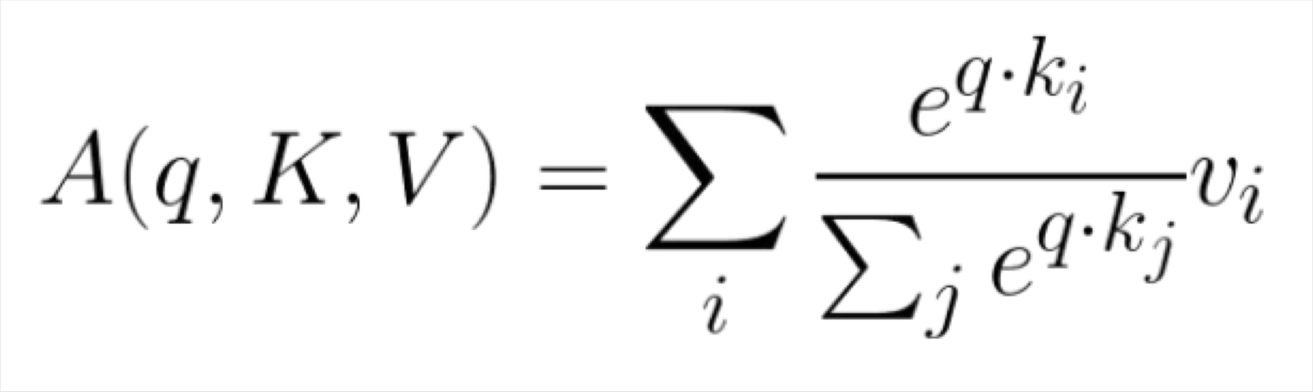
Dot-Product Attention (alternative slide)
Inputs: a query q and a set of key-value (k-v) pairs to an output
Query, keys, values, and output are all vectors
Output is weighted sum of values, where
Weight of each value is computed by an inner product of query and corresponding key
Queries and keys have same dimensionality d_{k ,} value have d_{v}
Christopher Manning

Slide 39
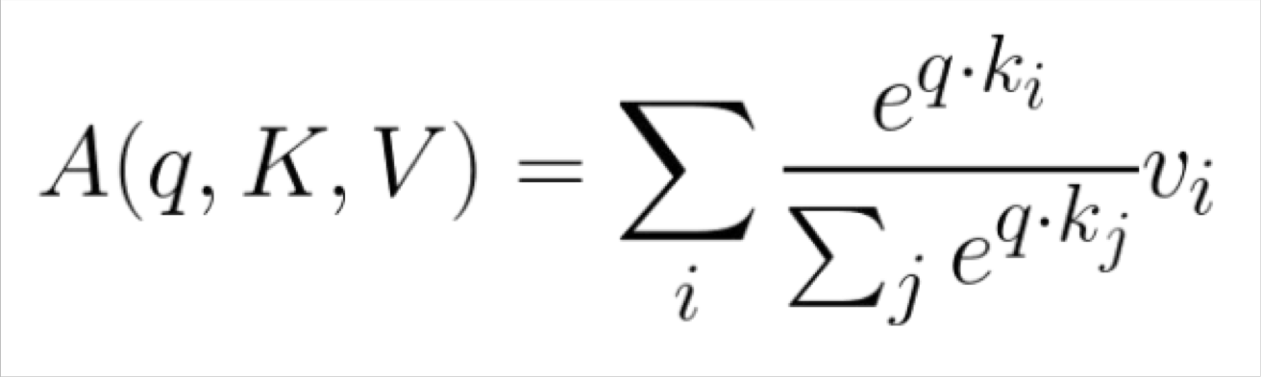
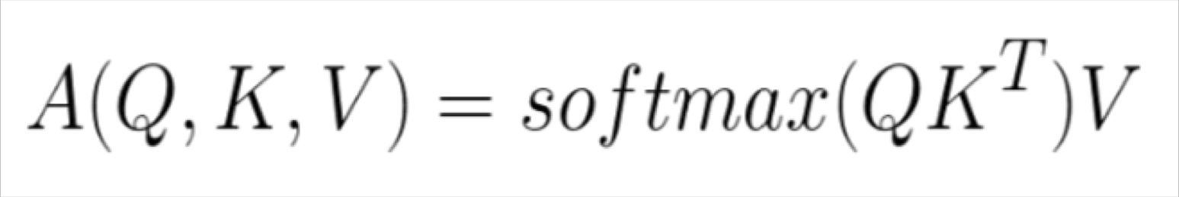
Dot-Product Attention – Matrix notation (alternative slide)
When we have multiple queries q, we stack them in a matrix Q
becomes:
[|Q| x d_{k}] x [d_{k} x |K|] x [|K| x d_{v}]
softmax row-wise
= [|Q| x d_{v}]
Christopher Manning

Slide 40
Barriers and solutions for Self-Attention as a building block
Barriers
Doesn’t have an inherent
notion of order!
No nonlinearities for deep learning magic! It’s all just weighted averages
Need to ensure we don’t “look at the future” when predicting a sequence
Like in machine translation
Or language modeling
Solutions
Add position representations to the inputs
Easy fix: apply the same feedforward network to each self- attention output.
Mask out the future by artificially setting attention weights to 0!
John Hewitt

Slide 41
Fixing the first self-attention problem: Sequence order
Since self-attention doesn’t build in order information, we need to encode the order of the
sentence in our keys, queries, and values.
Consider representing each sequence index as a vector
𝑝_{𝑖} ∈ ℝ^{𝑑}, for 𝑖 ∈ {1,2, … , 𝑇} are position vectors
Don’t worry about what the 𝑝_{𝑖} are made of yet!
Easy to incorporate this info into our self-attention block: just add the 𝑝_{𝑖} to our inputs!
Let 𝑣_{𝑖} ‘, 𝑘_{𝑖} ‘, 𝑞_{𝑖} ‘ be our old values, keys, and queries.
𝑣_{𝑖} = 𝑣_{𝑖} ‘ + 𝑝_{𝑖}
𝑞_{𝑖} = 𝑞_{𝑖} ‘ + 𝑝_{𝑖}
𝑘_{𝑖} = 𝑘_{𝑖} ‘ + 𝑝_{𝑖}
In deep self-attention networks, we do this at the first layer! You could concatenate them as well, but people mostly just add…
John Hewitt

Slide 42

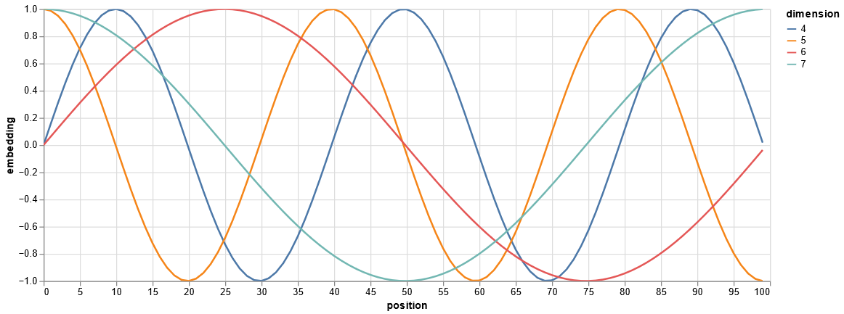
Position representation vectors through sinusoids
Sinusoidal position representations: concatenate sinusoidal functions of varying periods:
sin(𝑖/10000^{2∗1/𝑑}) cos(𝑖/10000^{2∗1/𝑑})
𝑝_{𝑖} =
𝑑
Image: https://timodenk.com/blog/linear-relationships-in-the-transformers-positional-encoding/
Dimension
sin(𝑖/10000^{2∗}2^{/𝑑})
𝑑
cos(𝑖/10000^{2∗}2^{/𝑑})
Index in the sequence
Image: http://nlp.seas.harvard.edu/annotated-transformer/
Pros: Periodicity indicates that maybe “absolute position” isn’t as important; maybe can extrapolate to longer sequences as periods restart. Cons: Not learnable.
Adapted from John Hewitt

Slide 43
Stacking self-attention
In the diagram at the right, we have stacked self-attention blocks, like we might stack LSTM layers.
The different layers capture a hierarchy of relationships within the data, similar to how convolutional networks capture a hierarchy of patterns that range from low- to high-level.
self-attention
𝑞₁
𝑘₁ 𝑣₁
𝑘₂
𝑞₂
𝑞₃
𝑞_{𝑇}
𝑣₂ 𝑘₃ 𝑣₃
𝑘_{𝑇}
𝑣_{𝑇}
…
self-attention
𝑘₂ 𝑣₂ 𝑘₃ 𝑞₃ 𝑣₃
𝑞₁
𝑘₁ 𝑣₁
𝑞₂
𝑘_{𝑇}
𝑞_{𝑇}
𝑣_{𝑇}
…
𝑤₁
The
𝑤₂
chef
𝑤₃
who
𝑤_{𝑇}
food
Adapted from John Hewitt

Slide 44
Adding nonlinearities in self-attention
Note that there are no elementwise nonlinearities in self-attention; stacking more self-attention layers just re-averages value vectors
Easy fix: add a feed-forward network
to post-process each output vector.
FF
FF
FF
self-attention
FF
…
FF
FF
FF
self-attention
FF
𝑚_{𝑖} = 𝑀𝐿𝑃 output_{𝑖}
= 𝑊₂ ∗ ReLU 𝑊₁ × output_{𝑖} + 𝑏₁
…
+ 𝑏₂
𝑤₁
The
𝑤₂
chef
𝑤₃
who
𝑤_{𝑇}
food
Intuition: the FF network processes the result of attention
John Hewitt

Slide 45
Masking the future in self-attention
We can look at these (not greyed out) words
To use self-attention in decoders, we need to ensure we can’t peek at the future.
−∞ | −∞ | −∞ | −∞
 | −∞ | −∞ | −∞
 |  | −∞ | −∞
 |  |  | −∞
[START]
To enable parallelization, we mask out attention to future words by setting attention scores to −∞.
𝑒_{𝑖𝑗} =
The
For encoding these words
chef
who
𝑞_{i}^{𝖳}𝑘_{𝑗}, 𝑗 < 𝑖
𝑖
−∞, 𝑗 ≥ 𝑖
Adapted from John Hewitt

Slide 46
Necessities for a self-attention building block:
Self-attention:
the basis of the method.
Position representations:
Specify the sequence order, since self-attention is an unordered function of its inputs.
Nonlinearities:
At the output of the self-attention block
Frequently implemented as a simple feed-forward network.
Masking:
In order to parallelize operations while not looking at the future.
Keeps information about the future from “leaking” to the past.
That’s it! But this is not the Transformer model we’ve been hearing about (yet).
Adapted from John Hewitt

Slide 47

Recall: Image Captioning with RNNs and Attention
Alignment scores:
H x W
Attention:
H x W
This entire process is differentiable.
- Model chooses its own attention weights. No attention
^{e}1,0,0 | ^{e}1,0,1 | ^{e}1,0,2
^{e}1,1,0 | ^{e}1,1,1 | ^{e}1,1,2
^{e}1,2,0 | ^{e}1,2,1 | ^{e}1,2,2
ª1,0,0
ª1,0,1
ª1,0,2
supervision is required.
ª1,1,0
ª1,1,1
ª1,1,2
person wearing hat
y₁ y₂ y₃
[END]
ª1,2,0
ª1,2,1
ª1,2,2
y₄
^{z}0,0
^{z}0,1
^{z}0,2
h₀
h₁
h₂
h₃
h₄
CNN
^{z}1,0
^{z}1,1
^{z}1,2
^{z}2,0
^{z}2,1
^{z}2,2
Extract spatial features from a pretrained CNN
Features: H x W x D
c₁
y₀
c₂
y₁
y₂
y₃
c₃
c₄
X
[START]
Lecture 9 -
person
47
wearing
hat
Xu et al, “Show, Attend and Tell: Neural Image Caption Generation with Visual Attention”, ICML 2015
Fei-Fei Li, Yunzhu Li, Ruohan Gao
Justin Johnson, Yunzhu Li, Ruohan Guo

Slide 48
Attention we saw in image captioning
c
Outputs:
context vector: c (shape: D)
mul + add
ª0,0 | ª0,1 |  | ª0,2
ª1,0 | ª1,1 |  | ª1,2
ª2,0 | ª2,1 |  | ª2,2
Attention
Operations:
Alignment: e_{i,j} = f_{att}(h, z_{i,j}) Attention: a = softmax(e) Output: c = ∑_{i,j} a_{i,j} z_{i,j}
softmax
^{z}0,0 | ^{z}0,1 | ^{z}0,2
^{z}1,0 | ^{z}1,1 | ^{z}1,2
^{z}2,0 | ^{z}2,1 | ^{z}2,2
^{e}0,0 |  | ^{e}0,1 |  | ^{e}0,2
^{e}1,0 |  | ^{e}1,1 |  | ^{e}1,2
^{e}2,0 |  | ^{e}2,1 |  | ^{e}2,2
Features
Alignment
Inputs:
Features: z (shape: H x W x D) Query: h (shape: D)
h
Fei-Fei Li, Yunzhu Li, Ruohan Gao
Justin Johnson, Yunzhu Li, Ruohan Guo

Slide 49
General attention layer (alternative slide)
c
Outputs:
context vector: c (shape: D)
mul + add
a₀
a₁
Attention
Operations:
Alignment: e_{i} = f_{att}(h, x_{i}) Attention: a = softmax(e) Output: c = ∑_{i} a_{i} x_{i}
a₂
softmax
Input vectors
x₀
e₀
Attention operation is permutation invariant.
Alignment
x₁
e₁
Doesn't care about ordering of the features
Stretch H x W = N into N vectors
x₂
e₂
Inputs:
Input vectors: x (shape: N x D) Query: h (shape: D)
h
Fei-Fei Li, Yunzhu Li, Ruohan Gao
Justin Johnson, Yunzhu Li, Ruohan Guo

Slide 50
General attention layer (alternative slide)
c
Outputs:
context vector: c (shape: D)
mul + add
a₀
a₁
Attention
Change f_{att}(.) to a simple dot product
- only works well with key & value transformation trick (will mention in a few slides)
Operations:
a₂
Alignment: e_{i} = h ᐧ x_{i}
Attention: a = softmax(e) Output: c = ∑_{i} a_{i} x_{i}
softmax
Input vectors
x₀
e₀
Alignment
x₁
e₁
x₂
e₂
Inputs:
Input vectors: x (shape: N x D) Query: h (shape: D)
h
Fei-Fei Li, Yunzhu Li, Ruohan Gao
Justin Johnson, Yunzhu Li, Ruohan Guo

Slide 51
General attention layer (alternative slide)
y₀
y₁ y₂
Outputs:
mul(→) + add (↑)
context vectors: y (shape: D)
Multiple query vectors
- each query creates a new output context vector
ª0,0
ª0,1
ª0,2
ª1,1
ª1,2
Attention
ª1,0
Operations:
Alignment: e_{i,j} = q_{j} ᐧ x_{i} / √D Attention: a = softmax(e) Output: y_{j} = ∑_{i} a_{i,j} x_{i}
ª2,1
ª2,2
Notice that the input vectors are used for both the alignment as well as the attention calculations.
ª2,0
softmax (↑)
Input vectors
- We can add more expressivity to the layer by adding a different FC layer before each of the two steps.
x₀
^{e}0,0 | ^{e}0,1 | ^{e}0,2
^{e}1,0 | ^{e}1,1 | ^{e}1,2
^{e}2,0 | ^{e}2,1 | ^{e}2,2
Alignment
x₁
x₂
q₁ |  | q₂
Inputs:
q₀
Input vectors: x (shape: N x D) Queries: q (shape: M x D)
Multiple query vectors
Fei-Fei Li, Yunzhu Li, Ruohan Gao
Justin Johnson, Yunzhu Li, Ruohan Guo

Slide 52
General attention layer (alternative slide)
y₀
y₁ y₂
Outputs:
context vectors: y (shape: D_{v} )
mul(→) + add (↑)
v
The input and output dimensions can now change depending on the key and value FC layers
v₀
ª0,0
ª0,1
ª0,2
v₁
ª1,1
ª1,2
Attention
ª1,0
Operations:
Key vectors: k = xW_{k}
v₂
ª2,0
ª2,1
ª2,2
Value vectors: v = xW_{v} Alignment: e_{i,j} = q_{j} ᐧ k_{i} / √D Attention: a = softmax(e) Output: y_{j} = ∑_{i} a_{i,j} v_{i}
softmax (↑)
Input vectors
x₀
k₀
^{e}0,0 | ^{e}0,1 | ^{e}0,2
^{e}1,0 | ^{e}1,1 | ^{e}1,2
^{e}2,0 | ^{e}2,1 | ^{e}2,2
Alignment
x₁
k₁
x₂
k₂
q₁ |  | q₂
Inputs:
Input vectors: x (shape: N x D) Queries: q (shape: M x D_{k})
q₀
Fei-Fei Li, Yunzhu Li, Ruohan Gao
Justin Johnson, Yunzhu Li, Ruohan Guo

Slide 53
Self attention layer (alternative slide)
We can calculate the query vectors from the input vectors, therefore, defining a "self-attention" layer.
Instead, query vectors are calculated using a FC layer.
Operations:
Key vectors: k = xW_{k} Value vectors: v = xW_{v} Query vectors: q = xW_{q}
Input vectors
Alignment: e_{i,j} = q_{j} ᐧ k_{i} / √D
x₀
Attention: a = softmax(e) Output: y_{j} = ∑_{i} a_{i,j} v_{i}
x₁
x₂
Inputs:
Input vectors: x (shape: N x D)
q₀ q₁ q₂
Queries: q (shape: M x D_{k})
No input query vectors anymore
Fei-Fei Li, Yunzhu Li, Ruohan Gao
Justin Johnson, Yunzhu Li, Ruohan Guo

Slide 54
Self attention layer (alternative slide)
y₀
y₁ y₂
Outputs:
context vectors: y (shape: D_{v})
mul(→) + add (↑)
v₀
ª0,0
ª0,1
ª0,2
v₁
ª1,1
ª1,2
Attention
ª1,0
Operations:
Key vectors: k = xW_{k}
v₂
ª2,0
ª2,1
ª2,2
Value vectors: v = xW_{v}
softmax (↑)
Query vectors: q = xW_{q} Alignment: e_{i,j} = q_{j} ᐧ k_{i} / √D Attention: a = softmax(e) Output: y_{j} = ∑_{i} a_{i,j} v_{i}
Input vectors
x₀
k₀
^{e}0,0
^{e}0,1
^{e}0,2
Alignment
x₁
k₁
^{e}1,0
^{e}1,1
^{e}1,2
x₂
k₂
^{e}2,0
^{e}2,1
^{e}2,2
Inputs:
Input vectors: x (shape: N x D)
q₀
q₁ q₂
Fei-Fei Li, Yunzhu Li, Ruohan Gao
Justin Johnson, Yunzhu Li, Ruohan Guo

Slide 55
Positional encoding
y₀ y₁ y₂
Options for pos(.)
1. Learn a lookup table:
self-attention
Learn parameters to use for pos(t) for t ε [0, T)
Lookup table contains T x d parameters.
x₀ x₁ x₂
p₀ p₁ p₂
position encoding
x₀ x₁ x₂
Concatenate special positional encoding p_{j} to each input vector x_{j}
We use a function pos: N →R^{d} to process the position j of the
vector into a d-dimensional vector
Desiderata of pos(.) :
It should output a unique encoding for each time-step (word’s position in a sentence)
Distance between any two time-steps should be consistent across sentences with different lengths.
Our model should generalize to longer sentences without any efforts. Its values should be bounded.
It must be deterministic.
So, p_{j} = pos(j)
Fei-Fei Li, Yunzhu Li, Ruohan Gao
Vaswani et al, “Attention is all you need”, NeurIPS 2017
63
Justin Johnson, Yunzhu Li, Ruohan Guo

Slide 56
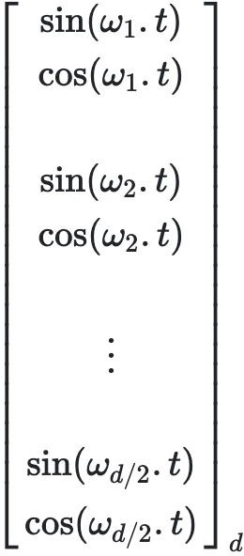
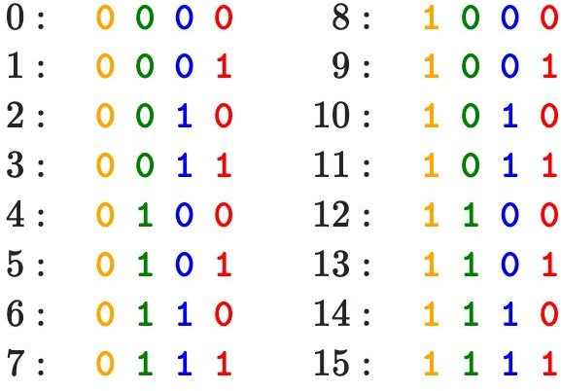
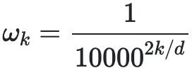
Positional encoding
y₀ y₁ y₂
Options for pos(.)
1. Learn a lookup table:
self-attention
Learn parameters to use for pos(t) for t ε [0, T)
Lookup table contains T x d parameters.
x₀ x₁ x₂
p₀ p₁ p₂
2. Design a fixed function with the desiderata
position encoding
x₀ x₁ x₂
Concatenate special positional encoding p_{j} to each input vector x_{j}
We use a function pos: N →R^{d} to process the position j of the
vector into a d-dimensional vector
Intuition:
p(t) =
where
So, p_{j} = pos(j)
Fei-Fei Li, Yunzhu Li, Ruohan Gao
image source
Vaswani et al, “Attention is all you need”, NeurIPS 2017
Justin Johnson, Yunzhu Li, Ruohan Guo

Slide 57

Transformer Overview
Attention is all you need. 2017. Aswani, Shazeer, Parmar, Uszkoreit, Jones, Gomez, Kaiser, Polosukhin https://arxiv.org/pdf/1706.03762.pdf
Non-recurrent sequence-to- sequence encoder-decoder model
Task: machine translation with parallel corpus
Predict each translated word
Final cost/error function is standard cross-entropy error on top of a softmax classifier
This and related figures from paper ⇑
Christopher Manning

Slide 58

Attention visualization in layer 5
Words start to pay attention to other words in sensible ways
Christopher Manning

Slide 59

Attention visualization: Implicit anaphora resolution
In 5th layer. Isolated attentions from just the word ‘its’ for attention heads 5 and 6. Note that the attentions are very sharp for this word.
Christopher Manning

Slide 60


Parallel attention heads
I
kicked
the
ball
Who
To whom?
Did what?
I
kicked
the
ball
Ashish Vaswani

Slide 61



The Transformer Encoder-Decoder [Vaswani et al., 2017]
Looking back at the whole model, zooming in on an Encoder block:
[predictions!]
Transformer Encoder
Transformer Decoder
[decoder attends to encoder states]
Transformer
Encoder
Transformer Decoder
Word Embeddings
+
Position Representations
Word
Embeddings
+
Position
Representations
[input sequence]
[output sequence]
John Hewitt

Slide 62
The Transformer Encoder-Decoder [Vaswani et al., 2017]
Next, let’s look at the Transformer Encoder and Decoder Blocks
What’s in a Transformer Encoder Block?
Key-query-value attention: How do we get the 𝑘, 𝑞, 𝑣 vectors from a single word embedding?
Multi-headed attention: Attend to multiple places in a single layer!
Tricks to help with training! (see hidden slides)
Residual connections
Layer normalization
Scaling the dot product
These tricks don’t improve what the model is able to do; they help improve the training process
Adapted from John Hewitt

Slide 63

The Transformer Encoder: Residual connections [He et al., 2016]
Residual connections are a trick to help models train better.
Instead of 𝑋^{(𝑖)} = Layer(𝑋 ^{𝑖−1} ) (where 𝑖 represents the layer)
_{𝑋}(𝑖−1) _{𝑋}(𝑖)
Layer
We let 𝑋^{(𝑖)} = 𝑋^{(𝑖−1)} + Layer(𝑋 ^{𝑖−1} ) (so we only have to learn “the residual”
from the previous layer)
_{𝑋}(𝑖−1) _{𝑋}(𝑖)
Layer
+
Residual connections are thought to make the loss landscape considerably smoother (thus easier training!)
[no residuals] [residuals]
[Loss landscape visualization, Li et al., 2018, on a ResNet]
John Hewitt

Slide 64
The Transformer Encoder: Layer normalization [Ba et al., 2016]
Layer normalization is a trick to help models train faster.
Idea: cut down on uninformative variation in hidden vector values by normalizing to unit mean and standard deviation within each layer.
LayerNorm’s success may be due to its normalizing gradients [Xu et al., 2019]
Let 𝑥 ∈ ℝ^{𝑑} be an individual (word) vector in the model.
Let 𝜇 = Σ_{j=1}^{𝑑} 𝑥_{𝑗} ; this is the mean; 𝜇 ∈ ℝ.
1
𝑑
Σ^{d}
2
𝑥 − 𝜇 ; this is the standard deviation; 𝜎 ∈ ℝ.
Let 𝜎 =
Let 𝛾 ∈ ℝ^{𝑑} and 𝛽 ∈ ℝ^{𝑑} be learned “gain” and “bias” parameters. (Can omit!)
Then layer normalization computes:
𝑗=1
𝑗
𝑥 − 𝜇
∗ 𝛾 + 𝛽
output =
∗ 𝛾 + 𝛽
Modulate by learned elementwise gain and bias
𝜎 + 𝜖
Normalize by scalar mean and variance
Modulate by learned elementwise gain and bias
John Hewitt

Slide 65
The Transformer Encoder: Scaled Dot Product [Vaswani et al., 2017]
“Scaled Dot Product” attention is a final variation to aid in Transformer training.
When dimensionality 𝑑 becomes large, dot products between vectors become large, inputs to the softmax function can be large, making gradients small.
Instead of the self-attention function we’ve seen:
output_{𝑃} = softmax 𝑋𝑄_{𝑃}𝐾^{𝖳}𝑋^{𝖳} ∗ 𝑋𝑉_{𝑃}
𝑃
We divide the attention scores by 𝑑/ℎ, to stop the scores from becoming large
just as a function of 𝑑/ℎ (The dimensionality divided by the number of heads.)
output_{𝑃} = softmax
𝑋𝑄_{𝑃}𝐾^{𝖳}𝑋^{𝖳}
∗ 𝑋𝑉_{𝑃}
𝑃
𝑑/ℎ
John Hewitt

Slide 66


The Transformer Encoder-Decoder [Vaswani et al., 2017]
Looking back at the whole model, zooming in on an Encoder block:
Transformer
Encoder
[predictions!]
Transformer Decoder
Residual + LayerNorm
[decoder attends to encoder states]
Feed-Forward
Residual + LayerNorm
Transformer Decoder
Multi-Head Attention
Word Embeddings
+
Position Representations
Word
Embeddings
+
Position
Representations
[input sequence]
[output sequence]
John Hewitt

Slide 67


The Transformer Encoder-Decoder [Vaswani et al., 2017]
Looking back at the whole model, zooming in on a Decoder block:
Transformer Encoder
[predictions!]
Transformer Decoder
Residual + LayerNorm Feed-Forward Residual + LayerNorm
Multi-Head Cross-Attention Residual + LayerNorm
Masked Multi-Head Self-Attention
Transformer
Encoder
Word Embeddings
+
Position Representations
Word
Embeddings
+
Position
Representations
[input sequence]
[output sequence]
John Hewitt

Slide 68
The Transformer Decoder: Cross-attention (details)
We saw self-attention is when keys, queries, and values come from the same source.
In the decoder, we have attention that looks more like what we saw last week.
Let ℎ₁, … , ℎ_{𝑇} be output vectors from the Transformer encoder; 𝑥_{𝑖} ∈ ℝ^{𝑑}
Let 𝑧₁, … , 𝑧_{𝑇} be input vectors from the Transformer decoder, 𝑧_{𝑖} ∈ ℝ^{𝑑}
Then keys and values are drawn from the encoder (like a memory):
𝑘_{𝑖} = 𝐾ℎ_{𝑖}, 𝑣_{𝑖} = 𝑉ℎ_{𝑖}.
And the queries are drawn from the decoder, 𝑞_{𝑖} = 𝑄𝑧_{𝑖}.
John Hewitt

Slide 69
The Transformer Encoder: Cross-attention (details)
Let’s look at how cross-attention is computed, in matrices.
Let H = ℎ₁; … ; ℎ_{𝑇}
Let Z = 𝑧₁; … ; 𝑧_{𝑇}
∈ ℝ^{𝑇×𝑑} be the concatenation of encoder vectors.
∈ ℝ^{𝑇×𝑑} be the concatenation of decoder vectors.
𝖳
The output is defined as output = softmax 𝑍𝑄 𝐻𝐾 × 𝐻𝑉.
First, take the query-key dot products in one matrix
All pairs of attention scores!
= 𝑍𝑄𝐾^{𝖳} 𝐻^{𝖳}
𝑍𝑄
multiplication: 𝑍𝑄 𝐻𝐾
𝖳
_{𝐾}𝖳 _{𝐻}𝖳
∈ ℝ
𝑇×𝑇
Next, softmax, and compute the weighted average with another matrix multiplication.
softmax
𝑍𝑄𝐾^{𝖳} 𝐻^{𝖳}
𝐻𝑉
=
output ∈ ℝ^{𝑇×𝑑}
John Hewitt

Slide 70
What would we like to fix about the Transformer?
Quadratic compute in self-attention:
Computing all pairs of interactions means our computation grows
quadratically with the sequence length!
For recurrent models, it only grew linearly!
Position representations:
Are simple absolute indices the best we can do to represent position?
Relative linear position attention [Shaw et al., 2018]
Dependency syntax-based position [Wang et al., 2019]
John Hewitt

Slide 71
Quadratic computation as function of seq. length
One of the benefits of self-attention over recurrence was that it’s highly
parallelizable.
However, its total number of operations grows as 𝑂 𝑇²𝑑 , where 𝑇 is the sequence length, and 𝑑 is the dimensionality.
= 𝑋𝑄𝐾^{𝖳} 𝑋^{𝖳}
Need to compute all pairs of interactions!
𝑂 𝑇²𝑑
𝑋𝑄
_{𝐾}𝖳 _{𝑋}𝖳
∈ ℝ
𝑇×𝑇
Think of 𝑑 as around 𝟏, 𝟎𝟎𝟎.
So, for a single (shortish) sentence, 𝑇 ≤ 30; 𝑇² ≤ 𝟗𝟎𝟎.
In practice, we set a bound like 𝑇 = 512.
But what if we’d like 𝑻 ≥ 𝟏𝟎, 𝟎𝟎𝟎? For example, to work on long documents?
John Hewitt

Slide 72


Recent work on improving on quadratic self-attention cost
Considerable recent work has gone into the question, Can we build models like
Transformers without paying the 𝑂 𝑇² all-pairs self-attention cost?
For example, Linformer [Wang et al., 2020]
Key idea: map the sequence length dimension to a lower- dimensional space for values, keys
Inference time (s)
Sequence length / batch size
John Hewitt

Slide 73

Recent work on improving on quadratic self-attention cost
Considerable recent work has gone into the question, Can we build models like
Transformers without paying the 𝑂 𝑇² all-pairs self-attention cost?
For example, BigBird [Zaheer et al., 2021]
Key idea: replace all-pairs interactions with a family of other interactions, like local windows, looking at everything, and random interactions.
John Hewitt

Slide 74
Pretraining models
In modern NLP:
All (or almost all) parameters in NLP
networks are initialized via pretraining.
Pretraining methods hide parts of the input from the model, and train the model to reconstruct those parts.
This has been exceptionally effective at building strong:
representations of language
parameter initializations for strong NLP
models.
𝒚
Pretrained jointly
… the movie was …
[This model has learned how to represent entire sentences through pretraining]
Adapted from John Hewitt

Slide 75


Pretraining for three types of architectures
The neural architecture influences the type of pretraining, and natural use cases.
Gets bidirectional context – can condition on future!
Wait, how do we pretrain them?
Encoders
Language models! What we’ve seen so far.
Nice to generate from; can’t condition on future words
Decoders
Encoder- Decoders
Good parts of decoders and encoders?
What’s the best way to pretrain them?
Adapted from John Hewitt

Slide 76
Pretraining through language modeling [Dai and Le, 2015]
Recall the language modeling task:
Model 𝑝_{𝜃} 𝑤_{𝑡} 𝑤_{1:𝑡−1}), the probability distribution over words given their past contexts.
There’s lots of data for this! (In English.)
goes
to
make
tasty
tea END
Decoder
(Transformer, LSTM, ++ )
Pretraining through language modeling:
Train a neural network to perform language modeling on a large amount of text.
Save the network parameters.
Iroh goes to
make
tasty tea
John Hewitt

Slide 77

The Pretraining / Finetuning Paradigm
Pretraining can improve NLP applications by serving as parameter initialization.
Step 1: Pretrain (on language modeling)
Lots of text; learn general things!
Step 2: Finetune (on your task)
Not many labels; adapt to the task!
goes to
make tasty tea END
☺/☹
Decoder
Decoder
(Transformer, LSTM, ++ )
(Transformer, LSTM, ++ )
Iroh
goes
to
make
tasty
tea
… the movie was …
John Hewitt

Slide 78
Capturing meaning via context: What kinds of things does pretraining learn?
There’s increasing evidence that pretrained models learn a wide variety of things about
the statistical properties of language:
Stanford University is located in , California. [Trivia]
I put fork down on the table. [syntax]
The woman walked across the street, checking for traffic over shoulder. [coreference]
I went to the ocean to see the fish, turtles, seals, and . [lexical semantics/topic]
Overall, the value I got from the two hours watching it was the sum total of the popcorn
and the drink. The movie was . [sentiment]
Iroh went into the kitchen to make some tea. Standing next to Iroh, Zuko pondered his destiny. Zuko left the . [some reasoning – this is harder]
I was thinking about the sequence that goes 1, 1, 2, 3, 5, 8, 13, 21, [some basic
arithmetic; they don’t learn the Fibonnaci sequence]
Models also learn – and can exacerbate racism, sexism, all manner of bad biases.
Adapted from John Hewitt

Slide 79
Pretraining encoders: What pretraining objective to use?
So far, we’ve looked at language model pretraining. But encoders get bidirectional context, so we can’t do language modeling!
Idea: replace some fraction of words in the input with a special [MASK] token; predict these words.
store
𝐴, 𝑏
ℎ₁, … , ℎ_{𝑇}
went
ℎ₁, … , ℎ_{𝑇} = Encoder 𝑤₁, … , 𝑤_{𝑇}
𝑦_{𝑖} ∼ 𝐴𝑤_{𝑖} + 𝑏
Only add loss terms from words that are “masked out.” If 𝑥 ’ is the masked version of 𝑥, we’re learning 𝑝_{𝜃}(𝑥|𝑥’ ). Called Masked LM.
I [M] to the [M]
[Devlin et al., 2018]
John Hewitt

Slide 80
BERT: Bidirectional Encoder Representations from Tranformers
Devlin et al., 2018 proposed the “Masked LM” objective and released the weights of a pretrained Transformer, a model they labeled BERT.
Some more details about Masked LM for BERT:
Predict a random 15% of (sub)word tokens.
Replace input word with [MASK] 80% of the time
Replace input word with a random token 10% of the time
Leave input word unchanged 10% of the time (but still predict it!)
Why? Doesn’t let the model get complacent and not build strong representations of non-masked words. (No masks are seen at fine-tuning time!)
[Predict these!]
went to
Transformer Encoder
store
I pizza to the [M]
[Replaced]
[Not replaced]
[Masked]
[Devlin et al., 2018]
John Hewitt

Slide 81
BERT: Bidirectional Encoder Representations from Tranformers
Mask out k% of the input words, and then predict the masked words
They always use k = 15%
store
↑
gallon
↑
the man went to the [MASK] to buy a [MASK] of milk
Too little masking: Too expensive to train
Too much masking: Not enough context
Christopher Manning

Slide 82

BERT: Bidirectional Encoder Representations from Tranformers
Additional task: Next sentence prediction
To learn relationships between sentences, predict whether Sentence B is actual sentence that proceeds Sentence A, or a random sentence
Adapted from Christopher Manning

Slide 83

BERT: Bidirectional Encoder Representations from Tranformers
The pretraining input to BERT was two separate contiguous chunks of text:
In addition to masked input reconstruction, BERT was trained to predict whether one chunk follows the other or is randomly sampled.
Later work has argued this “next sentence prediction” is not necessary.
[Devlin et al., 2018, Liu et al., 2019]
Adapted from John Hewitt

Slide 84
BERT: Bidirectional Encoder Representations from Tranformers
Details about BERT
Two models were released:
BERT-base: 12 layers, 768-dim hidden states, 12 attention heads, 110 million params.
BERT-large: 24 layers, 1024-dim hidden states, 16 attention heads, 340 million params.
Trained on:
BooksCorpus (800 million words)
English Wikipedia (2,500 million words)
Pretraining is expensive and impractical on a single GPU.
BERT was pretrained with 64 TPU chips for a total of 4 days.
(TPUs are special tensor operation acceleration hardware)
Finetuning is practical and common on a single GPU
“Pretrain once, finetune many times.”
[Devlin et al., 2018]
John Hewitt

Slide 85

BERT: Bidirectional Encoder Representations from Tranformers
BERT was massively popular and hugely versatile; finetuning BERT led to new state-of- the-art results on a broad range of tasks.
QQP: Quora Question Pairs (detect paraphrase questions)
QNLI: natural language inference over question answering data
SST-2: sentiment analysis
CoLA: corpus of linguistic acceptability (detect whether sentences are grammatical.)
STS-B: semantic textual similarity
MRPC: microsoft paraphrase corpus
RTE: small natural language inference corpus
John Hewitt
[Devlin et al., 2018]

Slide 86
Extensions of BERT
You’ll see a lot of BERT variants like RoBERTa, SpanBERT, +++
Some generally accepted improvements to the BERT pretraining formula:
RoBERTa: mainly just train BERT for longer and remove next sentence prediction!
SpanBERT: masking contiguous spans of words makes a harder, more useful pretraining task
It’s
bly
irr##
esi## sti## bly
BERT
SpanBERT
[MASK]
irr##
esi##
sti## [MASK] good
It’
[MASK] [MASK] [MASK] [MASK]
good
[Liu et al., 2019; Joshi et al., 2020]
John Hewitt

Slide 87

Extensions of BERT
A takeaway from the RoBERTa paper: more compute, more data can improve pretraining even when not changing the underlying Transformer encoder.
[Liu et al., 2019; Joshi et al., 2020]
John Hewitt

Slide 88
Pretraining decoders
It’s natural to pretrain decoders as language models and then
use them as generators, finetuning their 𝑝_{𝜃}
^{𝑤}𝑡 ^{𝑤}1:𝑡−1^{)!}
This is helpful in tasks where the output is a sequence with a vocabulary like that at pretraining time!
Dialogue (context=dialogue history)
Summarization (context=document)
𝑤₂ 𝑤₃ 𝑤₄ 𝑤₅ 𝑤₆
𝐴, 𝑏
ℎ₁, … , ℎ_{𝑇}
ℎ₁, … , ℎ_{𝑇} = Decoder 𝑤₁, … , 𝑤_{𝑇}
𝑤_{𝑡} ∼ 𝐴𝑤_{𝑡−1} + 𝑏
𝑤₁ 𝑤₂ 𝑤₃ 𝑤₄ 𝑤₅
[Note how the linear layer has been pretrained.]
Where 𝐴, 𝑏 were pretrained in the language model!
John Hewitt

Slide 89
Pretraining decoders
When using language model pretrained decoders, we can ignore that they were trained to model 𝑝 𝑤_{𝑡} 𝑤_{1:𝑡−1}).
We can finetune them by training a classifier
on the last word’s hidden state.
☺/☹
Linear
𝐴, 𝑏
ℎ₁, … , ℎ_{𝑇}
ℎ₁, … , ℎ_{𝑇} = Decoder 𝑤₁, … , 𝑤_{𝑇}
𝑦 ∼ 𝐴𝑤_{𝑇} + 𝑏
Where 𝐴 and 𝑏 are randomly initialized and specified by the downstream task.
𝑤₁, … , 𝑤_{𝑇}
Gradients backpropagate through the whole network.
[Note how the linear layer hasn’t been
pretrained and must be learned from scratch.]
John Hewitt

Slide 90
Generative Pretrained Transformer (GPT) [Radford et al., 2018]
2018’s GPT was a big success in pretraining a decoder!
Transformer decoder with 12 layers.
768-dimensional hidden states, 3072-dimensional feed-forward hidden layers.
Byte-pair encoding with 40,000 merges
Trained on BooksCorpus: over 7000 unique books.
Contains long spans of contiguous text, for learning long-distance dependencies.
The acronym “GPT” never showed up in the original paper; it could stand for
“Generative PreTraining” or “Generative Pretrained Transformer”
[Devlin et al., 2018]
John Hewitt

Slide 91
Generative Pretrained Transformer (GPT) [Radford et al., 2018]
How do we format inputs to our decoder for finetuning tasks?
Natural Language Inference: Label pairs of sentences as entailing/contradictory/neutral
Premise: The man is in the doorway
Hypothesis: The person is near the door
entailment
Radford et al., 2018 evaluate on natural language inference.
Here’s roughly how the input was formatted, as a sequence of tokens for the decoder.
[START] The man is in the doorway [DELIM] The person is near the door [EXTRACT]
The linear classifier is applied to the representation of the [EXTRACT] token.
John Hewitt

Slide 92

Generative Pretrained Transformer (GPT) [Radford et al., 2018]
GPT results on various natural language inference datasets.
John Hewitt

Slide 93

Increasingly convincing generations (GPT2) [Radford et al., 2018]
We mentioned how pretrained decoders can be used in their capacities as language models. GPT-2, a larger version of GPT trained on more data, was shown to produce relatively convincing samples of natural language.
John Hewitt

Slide 94
Aside: Word structure and subword models
Let’s take a look at the assumptions we’ve made about a language’s vocabulary.
We assume a fixed vocab of tens of thousands of words, built from the training set. All novel words seen at test time are mapped to a single UNK.
word hat learn
taaaaasty laern
vocab mapping pizza (index) tasty (index) UNK (index) UNK (index) UNK (index)
embedding
Common
words
Variations
misspellings
novel items
Transformerify
John Hewitt

Slide 95

Aside: Word structure and subword models
Finite vocabulary assumptions make even less sense in many languages.
Many languages exhibit complex morphology, or word structure.
The effect is more word types, each occurring fewer times.
Example: Swahili verbs can have hundreds of conjugations, each encoding a wide variety of information. (Tense, mood, definiteness, negation, information about the object, ++)
Here’s a small fraction of the
conjugations for ambia – to tell.
[Wiktionary]
John Hewitt

Slide 96
Aside: The byte-pair encoding algorithm
Subword modeling in NLP encompasses a wide range of methods for reasoning about structure below the word level. (Parts of words, characters, bytes.)
The dominant modern paradigm is to learn a vocabulary of parts of words (subword tokens).
At training and testing time, each word is split into a sequence of known subwords.
Byte-pair encoding is a simple, effective strategy for defining a subword vocabulary.
Start with a vocabulary containing only characters and an “end-of-word” symbol.
Using a corpus of text, find the most common adjacent characters “a,b”; add “ab” as a subword.
Replace instances of the character pair with the new subword; repeat until desired vocab size.
Originally used in NLP for machine translation; now a similar method (WordPiece) is used in pretrained
models.
[Sennrich et al., 2016, Wu et al., 2016]
John Hewitt

Slide 97
Aside: Word structure and subword models
Common words end up being a part of the subword vocabulary, while rarer words are split into (sometimes intuitive, sometimes not) components.
In the worst case, words are split into as many subwords as they have characters.
word
vocab mapping hat
learn
taa## aaa## sty la## ern## Transformer## ify
embedding
hat learn
taaaaasty laern
Common
words
Variations
misspellings
novel items
Transformerify
John Hewitt

Slide 98



Pretraining encoder-decoders: What pretraining objective to use?
What Raffel et al., 2018 found to work best was span corruption. Their model: T5.
Replace different-length spans from the input with unique placeholders; decode out the spans that were removed!
This is implemented in text preprocessing: it’s still an objective that looks like language modeling at the decoder side.
John Hewitt

Slide 99



Pretraining encoder-decoders: What pretraining objective to use?
A fascinating property of T5: it can be finetuned to answer a wide range of questions, retrieving knowledge from its parameters.
NQ: Natural Questions WQ: WebQuestions TQA: Trivia QA
220 million params
770 million params
3 billion params
11 billion params
All “open-domain”
versions
[Raffel et al., 2018]
John Hewitt

Slide 100
GPT-3, in-context learning, very large models
So far, we’ve interacted with pretrained models in two ways:
Sample from the distributions they define (maybe providing a prompt)
Fine-tune them on a task we care about, and take their predictions.
Very large language models seem to perform some kind of learning without gradient steps simply from examples you provide within their contexts.
GPT-3 is the canonical example of this. The largest T5 model had 11 billion parameters.
GPT-3 has 175 billion parameters.
John Hewitt

Slide 101
GPT-3, in-context learning, very large models
Very large language models seem to perform some kind of learning without gradient steps simply from examples you provide within their contexts.
The in-context examples seem to specify the task to be performed, and the conditional distribution mocks performing the task to a certain extent.
Input (prefix within a single Transformer decoder context):
“
thanks -> merci hello -> bonjour mint -> menthe otter -> ”
Output (conditional generations):
loutre…”
John Hewitt

Slide 102

GPT-3, in-context learning, very large models
Very large language models seem to perform some kind of learning without gradient steps simply from examples you provide within their contexts.
John Hewitt

Slide 103

Transformers in vision
Dosovitskiy, ICLR 2021, https://github.com/google-research/vision_transformer
https://www.youtube.com/watch?v=TrdevFK_am4

Slide 104

Cross-modal transformers
Chen et al., “UNITER: Learning UNiversal Image-TExt Representations”, arxiv 2019

Slide 105

Cross-modal transformers
Tan and Bansal, “LXMERT: Learning Cross-Modality Encoder Representationsfrom Transformers”, EMNLP 2019

Slide 106




Cost of training
ULMfit Jan 2018
Training: 1 GPU day
GPT
June 2018 Training
240 GPU days
BERT Oct 2018
Training
256 TPU days
~320–560
GPU days
GPT-2 Feb 2019
Training
~2048 TPU v3
days according to a reddit thread
Christopher Manning

